Slide 1
Agenda
Product Backlog Grooming
Estimation
Exam Reminder

Slide 2
Product Backlog
Central Component of the Scrum Process
Contains all desired product functionality
Initially developed as part of user story workshops done at the beginning of the project
User stories become product backlog items
Product backlog items may be features, defects, technical work, or knowledge acquisition
Product Backlog Example
Development of Scrum Alliance Website

Slide 3
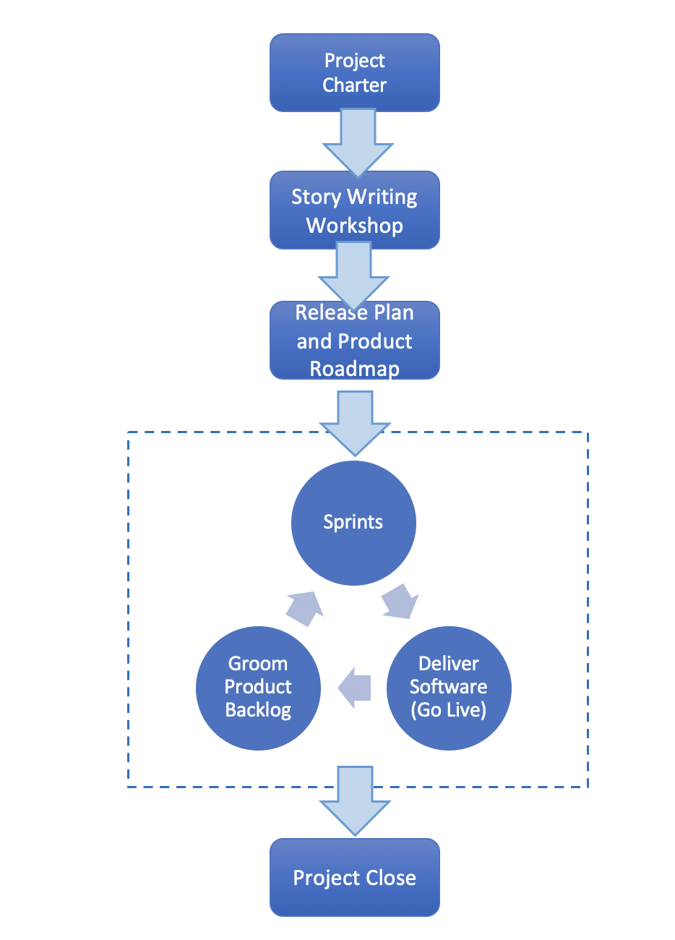
Scrum Flow
Project Charter
Business case, high level project scope, major milestones, product vision
User Story Development
Story writing workshops
Product Roadmap and Release Plan
Product backlog grooming
Sprint Execution
Multiple iterations
Release Software
Deploy software to operational environment
Project Close

Slide 4
Product Backlog Grooming
The process of elaborating on and prioritizing product backlog items
The product backlog is refined over time
Product backlog contains user stories at varying degrees of detail (epic, theme, story)
Lower priority items have fewer details
Progressive elaboration adds detail as we move forward with the process
Scrum is an agile process so we embrace and expect changes
Changes may occur during sprint planning or any other phase of the scrum process
Sprint backlog does not change once a sprint is started

Slide 5
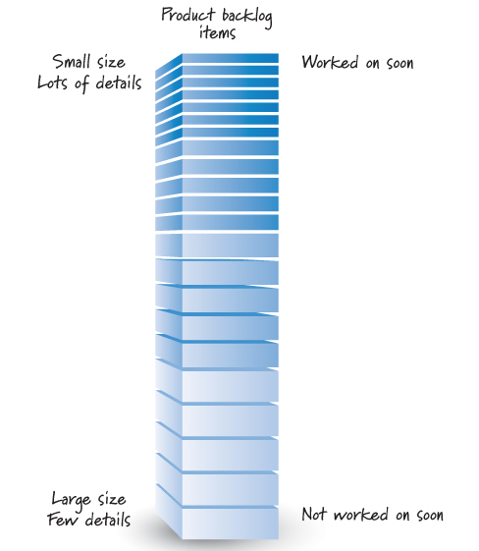
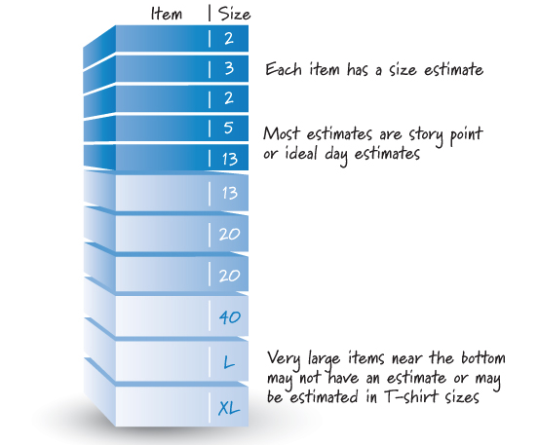
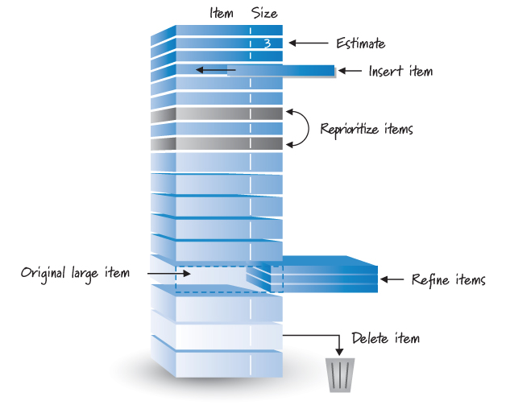
Product Backlog Grooming
Source: Essential Scrum

Slide 6
Estimation

Slide 7
What is estimation?
Estimates set expectations about the time required to complete the software
Stakeholders
Team
Organization’s management
If expectations are not realistic from the beginning of the project, the stakeholders will not trust the team or the project manager
“Unrealistic expectations based on inaccurate estimates are the single largest cause of IT project failure” (Futrell, Shafer and Shaefer, QSPM as quoted in Nelson and Morris MISQE 2014)

Slide 8
Estimation Techniques
Three Point Estimation
Analogous Estimation
Planning Poker

Slide 9
Three Point Estimation
Each Project Activity or PBI is Given Three Estimates
Most Likely Scenario
Optimistic Scenario
Pessimistic Scenario
Bottom-up approach where project delivery dates are calculated by rolling-up individual activity estimates
Indicates the level of uncertainty for each activity
Requires additional effort to provide 3 estimates for each activity
PERT
t_{e} = (nt_{m} + t_{o} + t_{p})/(n+2) where t_{m}= most likely estimate, t_{o}= optimistic estimate, and t_{p} = pessimistic estimate

Slide 10
Analogous Estimation
May be top-down or bottom-up
Find similar projects and/or activities and see how long they took
May require minimal effort and can be a good sanity check

Slide 11
Planning Poker
Common scrum technique for estimating prioritized list of Product Backlog Items
Estimate in Story Points or Ideal Days
Scrum Backlog Typically Contains
Features
Bugs
Technical Work
Knowledge Acquisition
Source: http://www.mountaingoatsoftware.com/agile/scrum/product-backlog

Slide 12
Planning Poker
Scrum Technique
Very similar to Delphi Approach
Scrum team estimates PBIs using a set of playing cards
Cards have numbers corresponding to size of estimate
Numbers are typically are not sequential
0, ½, 1, 2, 3, 5, 8, 13, 20, 40, 100
Relative Measure of Size
Tiny = ½, Small = 1, 2, 3, Medium = 5, 8, 13, Large = 20, 40, Epic = 100
Special Cards
Infinity, ?, pi

Slide 13
Planning Poker Protocol
The product owner selects a PBI to be estimated and reads the item to the team
Development team members discuss the item and ask clarifying questions to the product owner, who answers the questions
Each estimator privately selects a card representing his estimate
Once each estimator has made a private selection, all private estimates are simultaneously exposed to all estimators
If everyone selects the same card, we have consensus, and that consensus number becomes the PBI estimate
If the estimates are not the same, the team members engage in a focused discussion to expose assumptions and misunderstandings. Typically, we start by asking the high and low estimators to explain or justify their estimates.
After the discussion, we return to step 3 and repeat until consensus is reached.

Slide 14
Planning Poker
Agile Estimating and Planning
PlanningPoker.com

